Slide 1
Version control concepts & GIT Basics
Notes:
https://courses.cs.washington.edu/courses/cse403/13au/lectures/git.ppt.pdf
http://enos.itcollege.ee/~jpoial/allalaadimised/git/getting-started-with-git.pdf

Slide 2

Why Do We Need A Version Control System (VCS)?
Backup and Restore
Synchronization
Undo
Track Changes
Track Ownership
Sandboxing
Branching and merging
Notes:
https://betterexplained.com/articles/a-visual-guide-to-version-control/

Slide 3
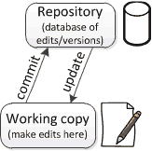
Repositories and working copies
Working copy
Personal copy of all the files.
We changes this copy, without affecting our teammates.
A repo/repository is
A database of all the edits and historical versions (snapshots) of project.
Commit changes to repo
When we are happy with changes

Slide 4
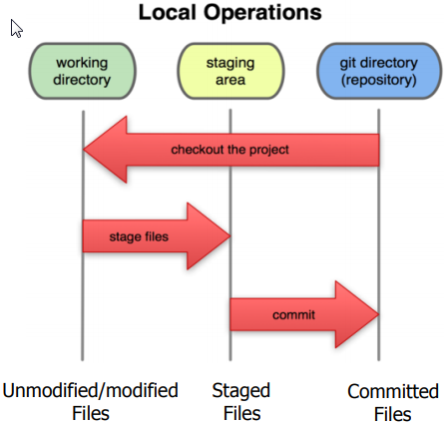
Local git operations
1
2
3

Slide 5

Workstation Setup
Visit
git-scm.com/downloads.
Detailed information
http://git-scm.com/book/en/Getting-Started-Installing-Git
First thing
git config --global user.name “My Name"
git config --global user.email myemail@gmail.com
Notes:
#Get the details of current config
git config --global user.name
git config --global user.email
git config --global user.name "My Name"
git config --global user.email myemail@gmail.com
#get current working directory
pwd
mkdir mygitrepo
cd mygitrepo
git init
git status
touch hello.txt
echo Hello, world! > hello.txt
git add hello.txt
git status
git commit -m "Add my first file"
#now do changed in the file - hello.txt again and run below command
vim hello.txt
git status
git add hello.txt
git status
git diff --staged
git commit -m "Add my file to staged"
git log
git log --since=yesterday
git log --since=2weeks
# now do the changes in working directory
vim hello.txt
# Optionaly stage the changes before git reset --hard
git add hello.txt
# Below command will remove any changes done and replace the contents of workinf directory from last commit
git reset --hard
#To view the statistics and facts about the last commit:
git show
# come out of current working directory and lets clone the repository from GitHuib
git clone https://github.com/leereilly/hello-world-java.git
cd hello-world-java
#The full address of that remote can be viewed with:
git remote -v
# push local repository to remote
git push origin master
# pull from remote to local repository
git pull

Slide 6

Let’s get started: Create a new Git Repository
Create a new directory
mkdir mygitrepo
cd mygitrepo
Initialize repository
git init
Check status of repository
git status
Create and commit file
$ touch hello.txt
$ echo Hello, world! > hello.txt

Slide 7
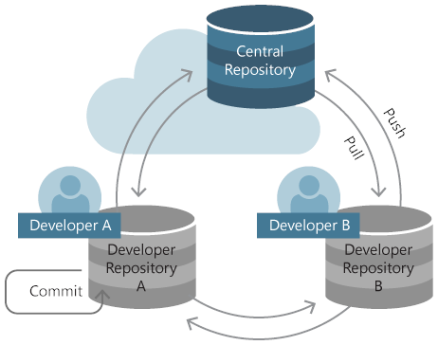
Lets get started: Create a new Git Repository
“register” the file for committing
$ git add hello.txt
Check status
$ git status
# On branch master
#
# Initial commit
#
# Changes to be committed:
# (use "git rm --cached <file>..." to unstage)
#
# new file: hallo.txt
#

Slide 8
Lets get started: Create a new Git Repository
Commit
$ git commit -m "Add my first file"

Slide 9
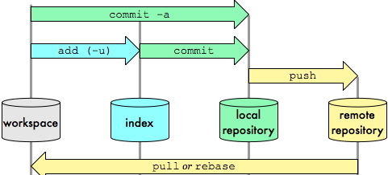

Slide 10
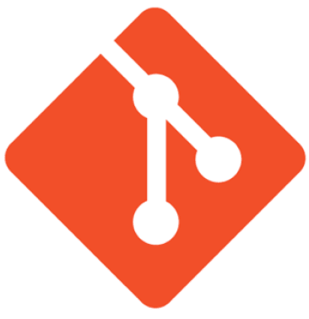
Git commands
Command | Description
git clone url [dir] | Copy a Git repository so we can add to it
git add file | Adds file contents to the staging area
git commit | Records a snapshot of the staging area
git status | View the status of our files in the working directory and staging area
git diff | Shows diff of what is staged and what is modified but unstaged
git help [command] | Get help info about a particular command
git pull | Fetch from a remote repo and try to merge into the current branch
git push | Push our new branches and data to a remote repository

Slide 11

GitHub.com
For online storage of Git repositories
Can create a remote repo there and push code to it
Free space for open source projects
Its not mandatory to use Github to use Git.
We can use Git locally for our own purposes.
We can also set up a git server locally

Slide 12


